Slide 1
CST 205 OOP :Object modeling using UML

Slide 2
OBJECTIVES
To explain about interaction diagrams.
To understand types of interaction diagrams.
To illustrate interaction diagrams.

Slide 3
Interaction diagram
Interaction diagrams, as their name itself implies, are models that describe how groups of objects interact among themselves through message passing to realise some behaviour.
Typically, each interaction diagram realises the behaviour of a single use case.
For complex use cases, more than one interaction diagrams may be necessary to capture the behaviour.
An interaction diagram shows a number of example objects and the messages that are passed between the objects within the use case.
The interaction diagrams play a major role in any effective object oriented design process.

Slide 4
Interaction diagram
Purpose of an Interaction Diagram
• To capture the dynamic behaviour of a system.
• To describe the message flow in the system.
• To describe the structural organization of the objects.
• To describe the interaction among objects.
Interaction diagram visualizes the communication and sequence of message passing in the system.
• Interaction diagram represents the ordered sequence of interactions within a system.
• Interaction diagrams can be used to explain the architecture of an object-oriented system.

Slide 5
Different types of Interaction diagram
1. Sequence diagram
• Purpose - To visualize the sequence of a message flow in the system
• Shows the interaction between two lifelines.
2. Collaboration diagram
• Also called as a communication diagram.
• Shows how various lifelines in the system connects.
3. Timing diagram
• Focus on the instance at which a message is sent from one object to
another object.

Slide 6
Different types of Interaction diagram
1. Sequence diagram
A sequence diagram shows interaction among objects as a two
dimensional chart.
The chart is read from top to bottom.
The objects participating in the interaction are shown at the top of the chart as boxes attached to a vertical dashed line.
Inside the box the name of the object is written with a colon separating it from the name of the class and both the name of the object and the class are underlined.

Slide 7
Different types of Interaction diagram
1. Sequence diagram
The vertical dashed line is called the object’s lifeline.
Any point on the lifeline implies that the object exists at that point. Absence of lifeline after some point indicates that the object ceases to exist after that point in time, particular point of time.
A rectangle called the activation symbol is drawn on the lifeline of an object to indicate the points of time at which the object is active.
Thus an activation symbol indicates that an object is active as long as the symbol (rectangle) exists on the lifeline.
Each message is indicated as an arrow between the lifelines of two objects. The messages are shown in chronological order from the top to the bottom.

Slide 8
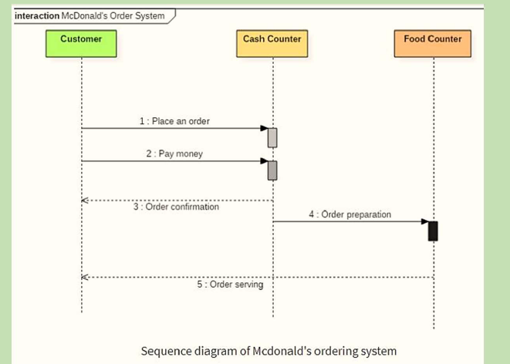
Example of Sequence diagram

Slide 9
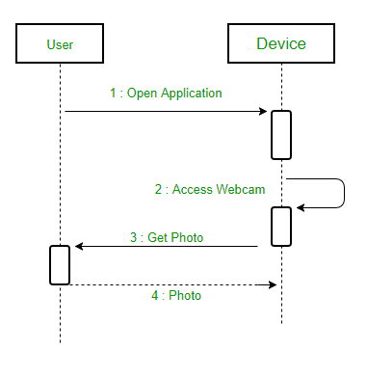
Example of Sequence diagram

Slide 10
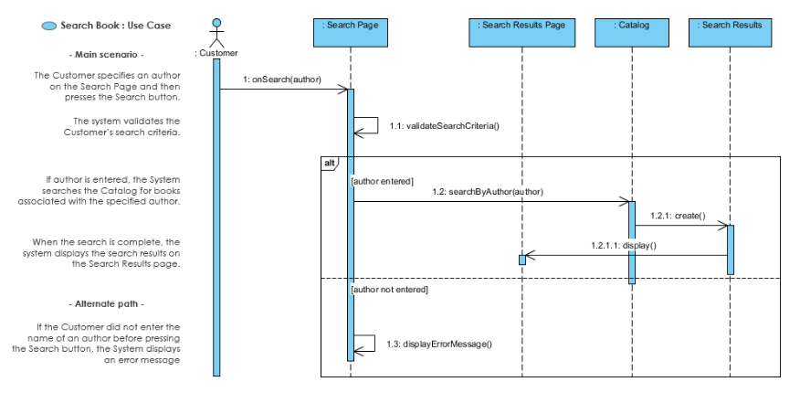
Example of Sequence diagram

Slide 11
Example of Sequence diagram
Purpose of Sequence Diagram
Model high-level interaction between active objects in a system
Model the interaction between object instances within a collaboration that realizes a use case.
Model the interaction between objects within a collaboration that realizes an operation.
Either model generic interactions (showing all possible paths through the interaction) or specific instances of a interaction (showing just one path through the interaction)

Slide 12
Collaboration diagram
A collaboration diagram shows both structural and behavioural aspects
explicitly.
This is unlike a sequence diagram which shows only the behavioural aspects.
The structural aspect of a collaboration diagram consists of objects and links among them indicating association.
The behavioural aspect is described by the set of messages exchanged among the different objects.

Slide 13
Collaboration diagram
A Collaboration is a collection of named objects and actors with links connecting them. They collaborate in performing some task.
The collaboration diagram is used to show the relationship between the objects in a system.
The sequence and the collaboration diagrams represent the same information but differently.
Instead of showing the flow of messages, it depicts the architecture of the object residing in the system as it is based on object-oriented programming.
The collaboration diagram, which is also known as a communication diagram, is used to portray the object's architecture in the system.

Slide 14
Purpose of Collaboration diagram
Model collaborations between objects or roles that deliver the functionalities of use cases and operations.
Better suited for analysis activities.
Support the identification of objects (hence classes) that participate in use cases.
Model alternative scenarios within use cases.

Slide 15
Notations of a Collaboration Diagram
Objects: The representation of an object is done by an object symbol with its name and class underlined, separated by a colon.
Actors: In the collaboration diagram, the actor plays the main role as it invokes the interaction. Each actor has its respective role and name.
Links: The link is an instance of association, which associates the objects and actors. It is represented by a solid line.
Messages: It is a communication between objects which carries information and includes a sequence number, so that the activity may take place. It is represented by a labelled arrow, which is placed near a link. The messages are sent from the sender to the receiver and the receiver must understand the message.

Slide 16
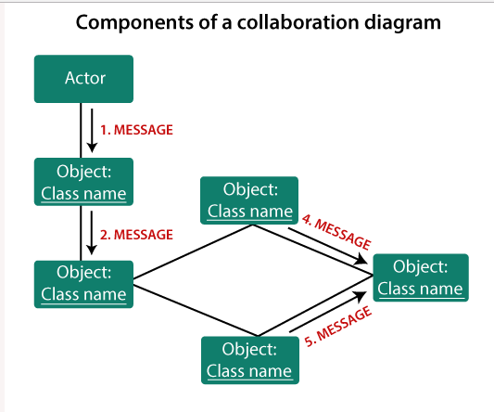
Notations of a Collaboration Diagram

Slide 17
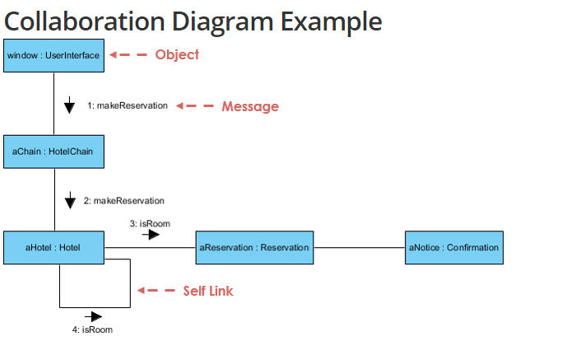
Collaboration Diagram Example

Slide 18
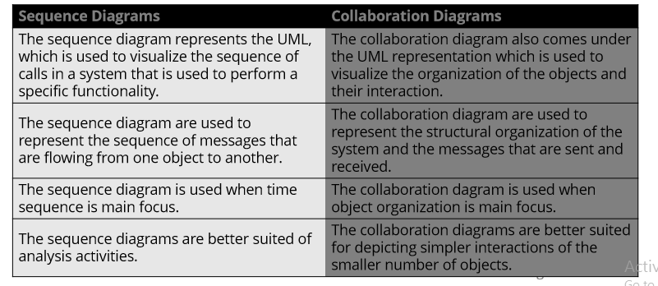
DIFFERENCE BETWEEN SEQUENCE DIAGRAM AND COLLABORATION DIAGRAM

Slide 19
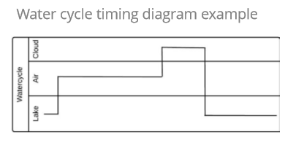
TIMING DIAGRAM
Timing diagram is a waveform or a graph that is used to describe the state of a lifeline at any instance of time.
It is used to denote the transformation of an object from one form into another form.
Timing diagram does not contain notations as required in the sequence and collaboration diagram.
The flow between the software program at various instances of time is represented using a waveform.

Slide 20
ACTIVITY DIAGRAM
Activity diagram is another important behavioral diagram in UML diagram to describe dynamic aspects of the system.
Activity diagram is essentially an advanced version of flow chart that modelling the flow from one activity to another activity.
The activity can be described as an operation of the system.
The activity diagram focuses on representing various activities. An activity is a state with an internal action and one or more outgoing transitions which automatically follow the termination of the internal activity.
Activity diagrams support description of parallel activities.
It is also called object-oriented flowchart.

Slide 21
ACTIVITY DIAGRAM
An activity diagram portrays the control flow from a start point to a finish point showing the various decision paths that exist while the activity is being executed.
We can depict both sequential processing and concurrent processing of activities using an activity diagram.
They are used in business and process modelling where their primary use is to depict the dynamic aspects of a system.

Slide 22




Activity Diagram Notations
Activity -Is used to represent a set of actions
Action -A task to be performed
Control Flow Shows the sequence of execution. Illustrate the transitions from one action state to another.
Initial Node -Portrays the beginning of a set of actions or activities
Activity Final Node Stop all control flows and object flows in an activity (or action)
Decision Node Represent a test condition to ensure that the control flow or object flow only goes down one path
Object Node Represent an object that is connected to a set of Object Flows

Slide 23
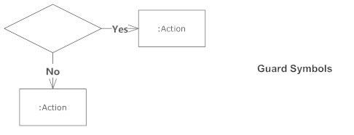
Activity Diagram Notations
Guards
In UML, guards are a statement written next to a decision diamond that must be true before moving to the next activity.

Slide 24
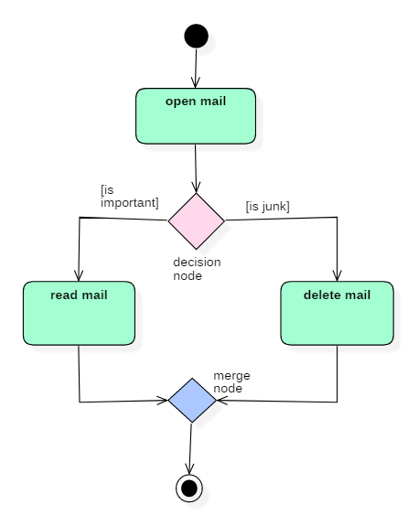
Example of Activity Diagram

Slide 25
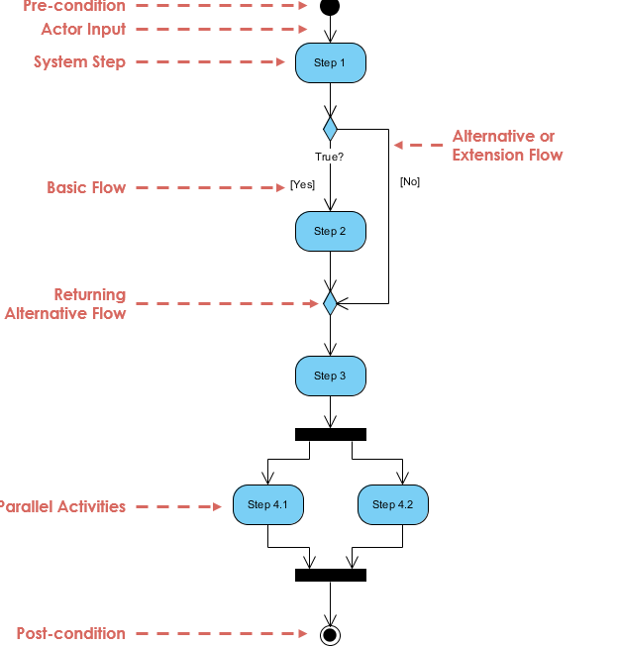
A basic activity diagram - flowchart like

Slide 26
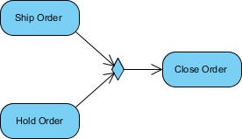
Activity Diagram Notations
Merge
It represents a merge point where multiple alternate execution paths will meet and continue.
It is drawn as a small diamond shape with multiple incoming control flows and on outgoing control flow.
Example
The merge point where Ship Order and Hold Order meet can be drawn in the diagram as a Merge Notation as shown below:

Slide 27
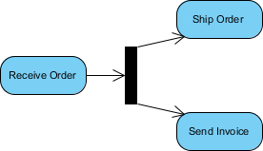
Activity Diagram Notations
Fork
It represents a fork action that splits a single execution flow into multiple concurrent execution flows.
It is drawn as a short solid line with one incoming control flow on one side and multiple outgoing control flows on the other side.
Example
The fork action performed after the Receive Order action to start Ship Order action and Send Invoice action concurrently can be drawn in the diagram as shown below:

Slide 28
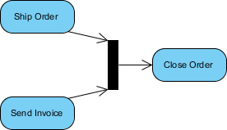
Activity Diagram Notations
Join
It represents a join action that waits for multiple concurrent execution flows to finish.
It is drawn as a short solid line with multiple incoming control flows on one side and one outgoing control flows on the other side.
Example
Join action performed before the Close Order action to wait for both Ship Order action and Send Invoice action to finish can be drawn as in the diagram as shown below:

Slide 29
Activity Diagram Notations
Swimlane
Partition presents a group of actions and objects that share some common properties.
It is drawn as two parallel lines with the partition name as one end.
Any actions and objects that are located within the two lines are considered to be in the group.
We use swimlanes for grouping related activities in one column.
Swimlanes group related activities into one column or one row.
Swimlanes can be vertical and horizontal.

Slide 30
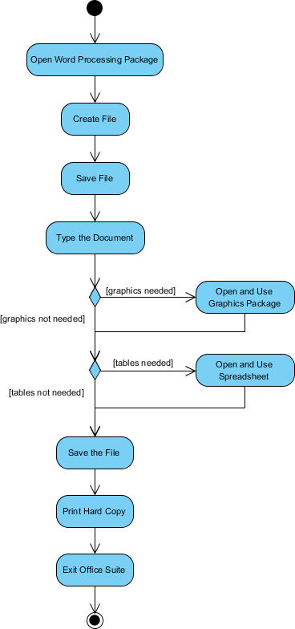
Activity Diagram - Modeling a Word Processor

Slide 31
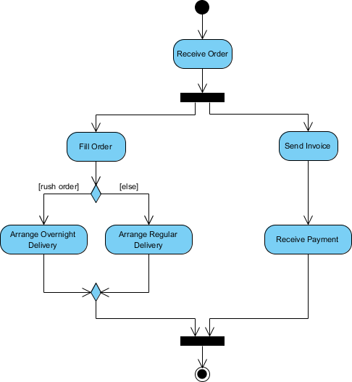
Activity Diagram - - Process Order

Slide 32
Activity Diagram - Swimlane
Parallel activities are represented on an activity diagram by using swimlanes.
Swim lanes enable you to group activities based on who is performing them, e.g., academic department vs. hostel office.
Thus swimlanes subdivide activities based on the responsibilities of some components.
Partition presents a group of actions and objects that share some common properties.
Any actions and objects that are located within the two lines are considered to be in the group.
We use swim lanes for grouping related activities in one column.
Swimlanes group related activities into one column or one row.
Swimlanes can be vertical and horizontal.

Slide 33
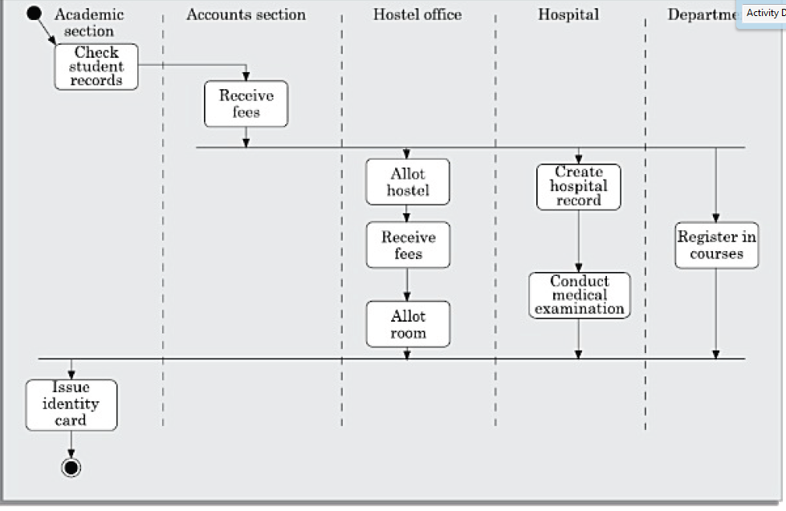
Activity diagram for student admission procedure at IIT. - Swimlane

Slide 34
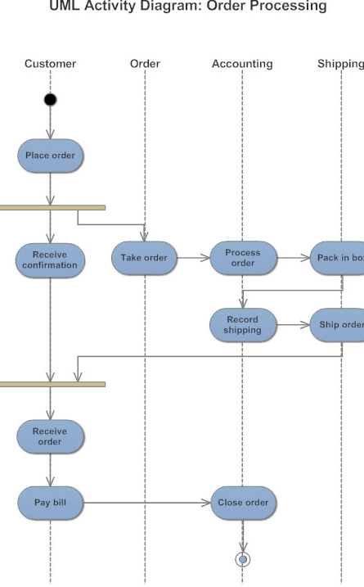

Slide 35
USES OF ACTIVITY DIAGRAM
Activity diagrams are normally employed in business process modelling.
Activity diagrams can be very useful to understand complex processing activities involving the roles played by many components.
These diagrams can also be used to develop interaction diagrams which help to allocate activities (responsibilities) to classes.

Slide 36
STATE CHART DIAGRAM
A state chart diagram is normally used to model how the state of an
object changes in its life time.
State chart diagrams are good at describing how the behaviour of an object changes across several use case executions.
State chart diagrams show the different states of an entity.
State machine diagrams can also show how an entity responds to various events by changing from one state to another.
State machine diagram is a UML diagram used to model the dynamic nature of a system.

Slide 37
STATE CHART DIAGRAM
It is also called a Statemachine or StateTransition diagram.
An object goes through various states during its lifespan.
The lifespan of an object remains until the program is terminated.
Each state represents some unique information about the object.
A state machine diagram describes all events (and states and transitions for a single object)
In most OO techniques, state diagrams are drawn for a single class to show the lifetime behavior of a single object. They describe all of the possible states that a particular object (or even the entire system) can get into.

Slide 38
Basic elements of a state chart
State - A state is a constraint or a situation in the life cycle of an object .These are represented by rectangles with rounded corners.
Initial state: This represented as a filled circle.
Final state: This is represented by a filled circle inside a larger circle.
Events -An event is described as Event-name (comma-separated-parameter-list). Events appear in the internal transition compartment of a state or on a transition between states.
Transition - Transition lines depict the movement from one state to another. Each transition line is labelled with the event that causes the transition.

Slide 39
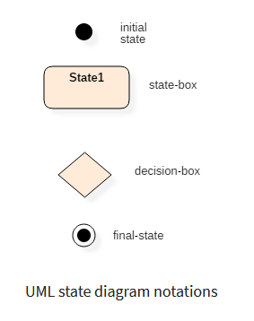
Basic elements of a state chart

Slide 40
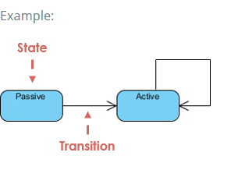
Basic elements of a state chart
What is a State?
A state occupies an interval of time.
State represent the conditions of objects at certain points in time.
An entity changes its state not only as a direct consequence of the current input, but it is also dependent on some past history of its inputs.
A state machine diagram is a graph consisting of:
States (simple states or composite states)
State transitions connecting the states

Slide 41
Basic elements of a state chart
Events
Represents incidents that cause objects to transition from one state to another.
Internal or External Events trigger some activity that changes the state of the system and of some of its parts.
An event signature is described as Event-name (comma-separated-parameter-list).
Events appear in the internal transition compartment of a state or on a transition between states.

Slide 42
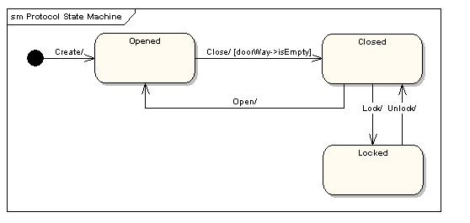
state machine diagram shows the states that a door goes through during its lifetime.

Slide 43
state machine diagram shows the states that a door goes through during its lifetime.
The door can be in one of three states: "Opened", "Closed" or "Locked".
It can respond to the events Open, Close, Lock and Unlock.
Notice that not all events are valid in all states; for example, if a door is opened, you cannot lock it until you close it.
Also notice that a state transition can have a guard condition attached: if the door is Opened, it can only respond to the Close event if the condition doorWay->isEmpty is fulfilled.

Slide 44
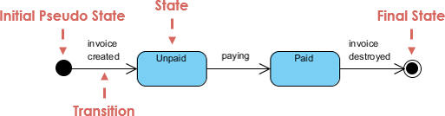
Basic elements of a state chart

Slide 45
ACTIVITY DIAGRAM VS STATE DIAGRAM
Both activity and state chart diagrams model the dynamic behavior of the system.
Activity diagram is essentially a flowchart showing flow of control from activity to activity.
A state chart diagram shows a state machine emphasizing the flow of control from state to state.
An activity diagram is a special case of a state chart diagram in which all or most of the states are activity states and all or most of the transitions are triggered by completion of activities in the source state (An activity is an ongoing non-atomic execution within a state machine).
Activity diagrams may stand alone to visualize, specify, and document the dynamics of a society of objects or they may be used to model the flow of control of an operation. State chart diagrams may be attached to classes, use cases, or entire systems in order to visualize, specify, and document the dynamics of an individual object.

Slide 46
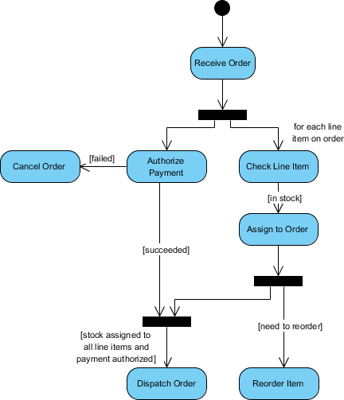
ACTIVITY DIAGRAM

Slide 47
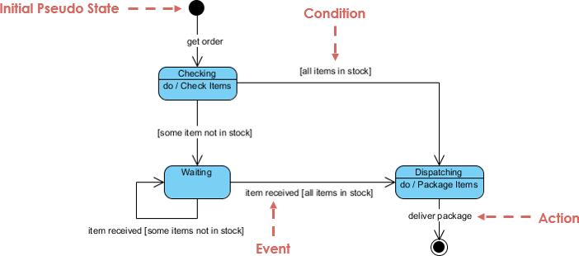
STATE DIAGRAM

Slide 48
State chart Diagram
Following are the main purposes of using Statechart diagrams −
To model the dynamic aspect of a system.
To model the life time of a reactive system[a system that responds to external or internal events.]
To describe different states of an object during its life time.
Define a state machine to model the states of an object.

Slide 49
SUMMARY
https://www.visual-paradigm.com/guide/uml-unified-modeling-language/what-is-state-machine-diagram/
We discussed the syntax and semantics of major UML diagrams .
Explained the purpose of each UML diagram.

Slide 50
Thanks!
Any questions?

